Slide 1
CO 2
Session no. 20

Slide 2
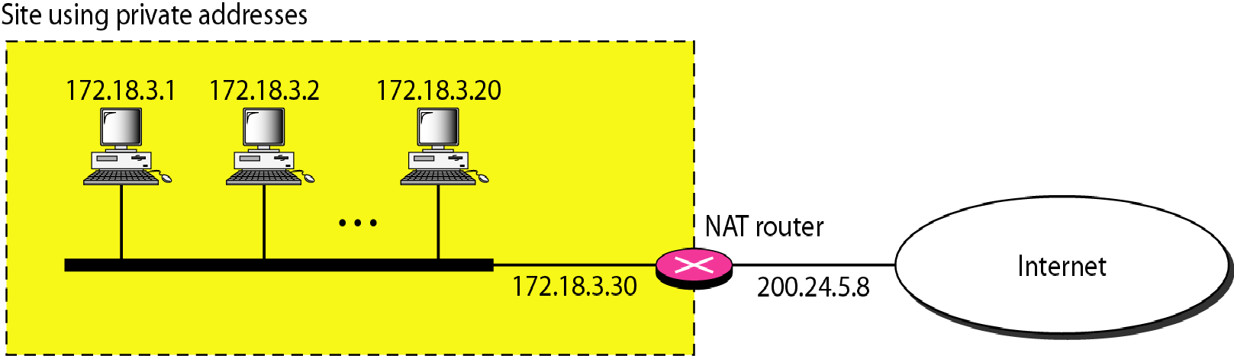
A NAT implementation

Slide 3
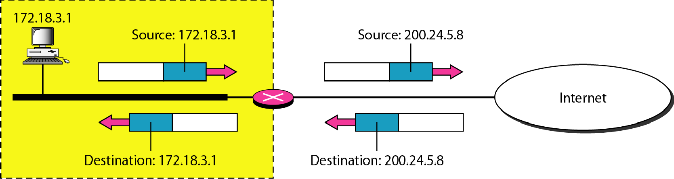
Addresses in a NAT

Slide 4
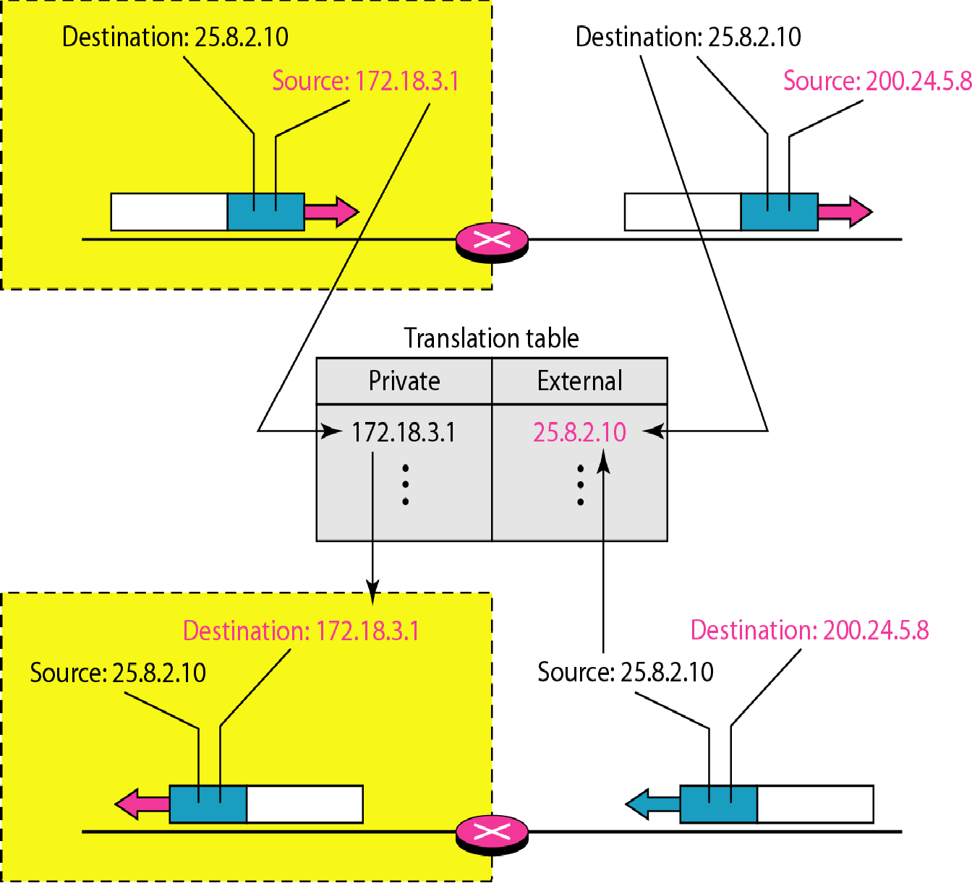
NAT address translation

Slide 5
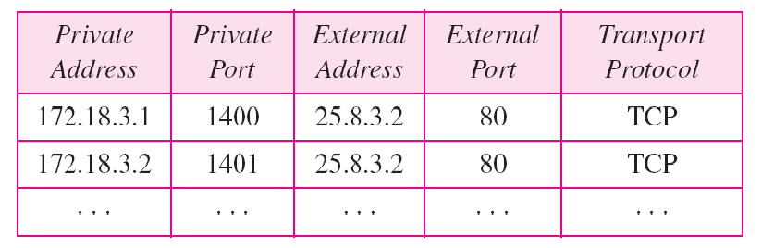
Table: PAT Five-column translation table
PORT ADDRESS TRANSLATION

Slide 6
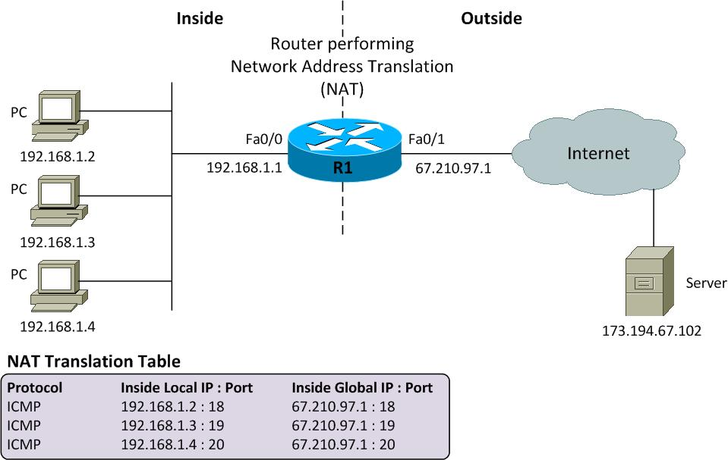
pat

Slide 7
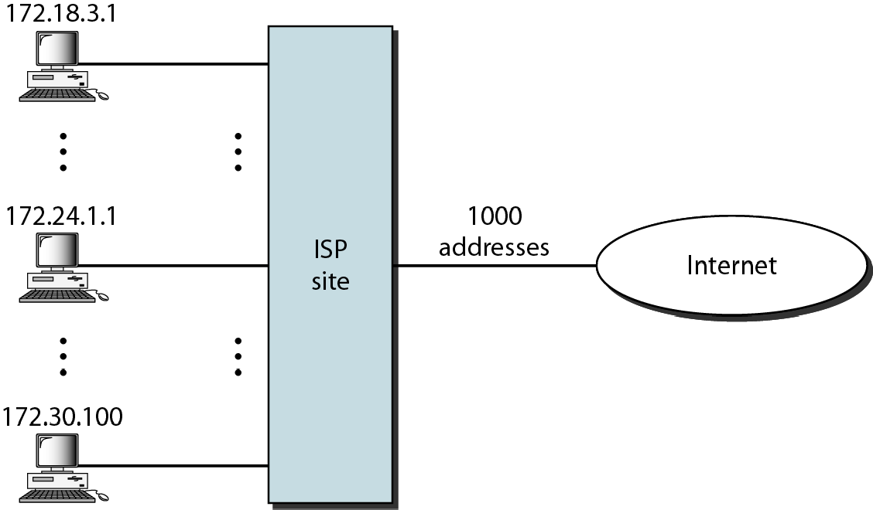
An ISP and NAT

Slide 8
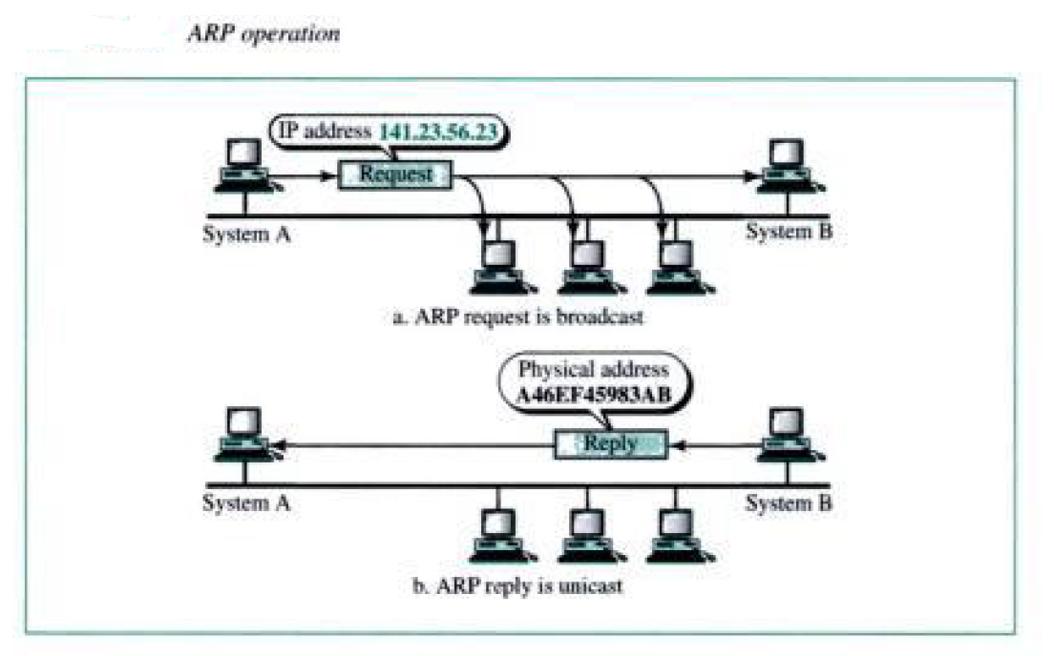
Address resolution protocol

Slide 9
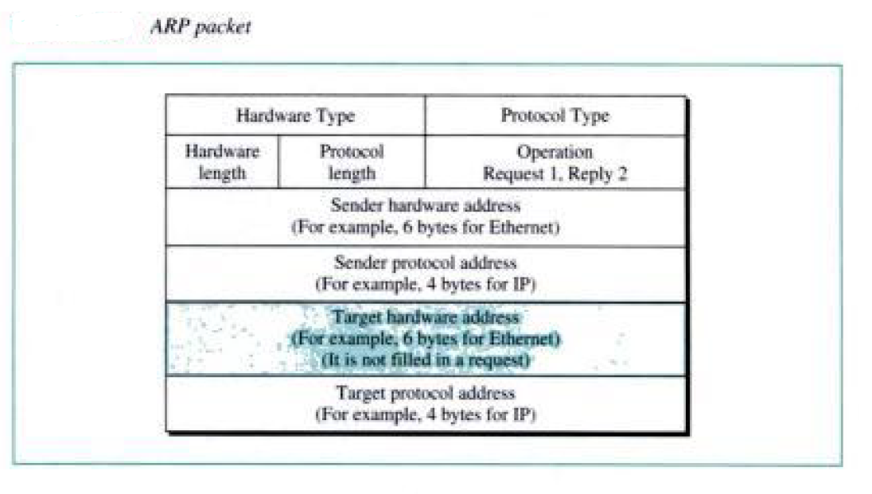
ARP packet format

Slide 10
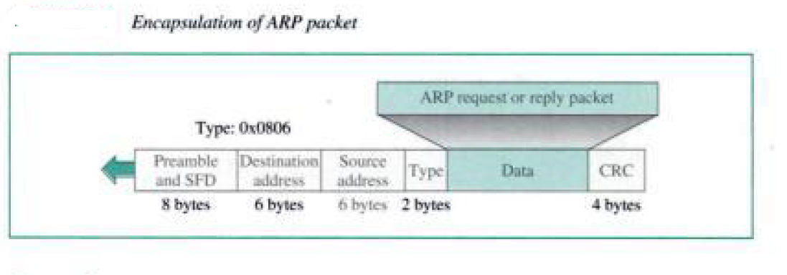
Arp encaptulation

